Slide 1
Small market, big impact:
Business Aviation in the Middle East
Oren Katzen Regional Marketing Director
Notes:
בוקר טוב לכולם, שמי אורן קצן ואני נציג בואינג בארץ
Good morning, my name is Oren Katzen and I’m BBJ’s marketing director based here in Israel.
It’s a pleasure to be here at this conference and we’re delighted with the relationship we’ve built with Gal, Ron and the Jetsetter team. Thank you for continuing to promote business aviation in Israel.
Even though this is our first TLV BAC, BBJ is no stranger to the Middle East market. Quite the opposite, in fact.

Slide 2
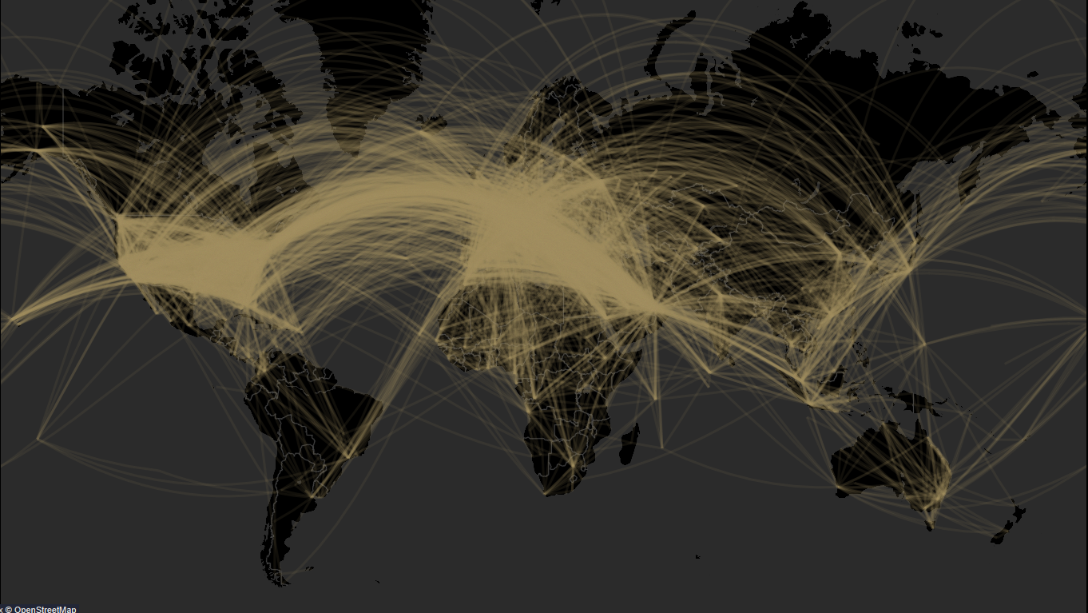
BBJs connect the world
Notes:
Our BBJs connect the world. We operate on every continent, every mission from long to short range, in every customer segment of the private jet ecosystem. (private, gov, charter, corporate)
Source: WingX data for all BBJs included in our fleet list (~253 airplanes, i.e. includes widebodies).
Shows all flights from 01/01/2019 through 09/27/2022. The lines are intentionally slightly transparent to allow the map to be seen and to demonstrate the density of flights in the US, Europe and Middle East.
Bottom line: BBJs go just about everywhere.

Slide 3
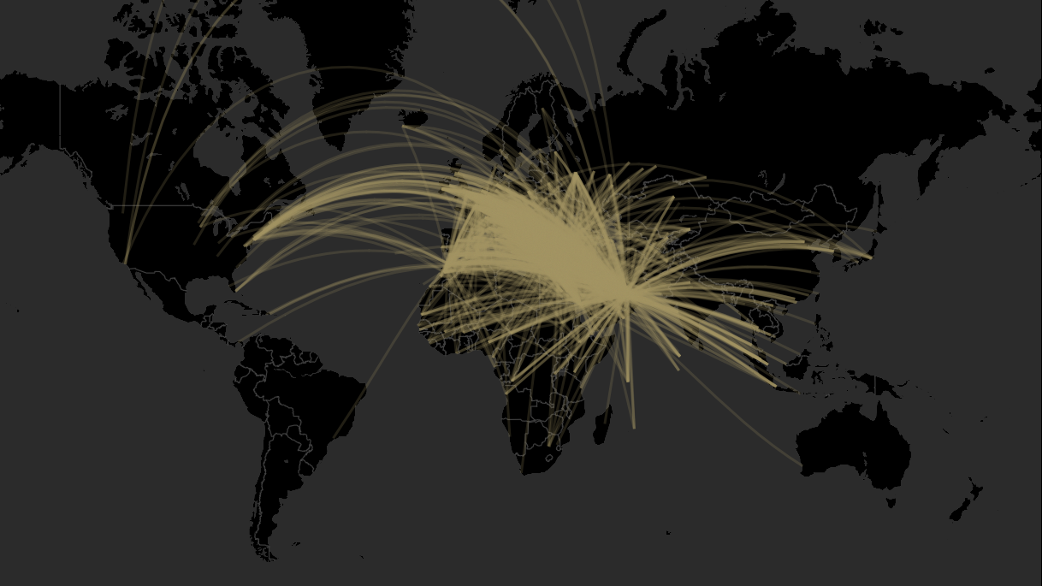
34% of BBJ flights arrive or depart in the Middle East
2019-2022 flights from WingX
Notes:
And when we look at the Middle East,
34% of all BBJ flights since 2019 either departed from or arrived in a Middle East country. So while the rest of the bizjet market is more heavily weighted towards the USA, a signifanct portion of our customer base is here in this region.
Our 2 biggest BBJ operators are just a 3 hour flight from where we stand.
Middle East includes:
Afghanistan
Algeria
Cyprus
Egypt
Iran,
Islamic Republic of Iraq
Israel
Jordan
Kuwait
Lebanon
Libya
Morocco
Oman
Pakistan
Palestine,
State of Qatar
Saudi Arabia
South Sudan
Sudan
Syrian Arab Republic
Tunisia
Turkey
United Arab Emirates
Yemen
Source: WingX data for all BBJs included in our fleet list (~253 airplanes, i.e. includes widebodies).
Shows all flights from 01/01/2019 through 09/27/2022. The lines are intentionally slightly transparent to allow the map to be seen and to demonstrate the density of flights

Slide 4
Middle East: small market, big impact
Home to only 2.5% of all business jets
Africa
but 55% are in the large & BBJ segments
APAC
Europe
Latin America
Smaller bizjets
Middle East
Large bizjets & BBJ segment
Large defined as MTOW of 60,000 lb or greater
Notes:
I want to talk for a moment about why the Middle East is such an important market for BBJ.
Our market assessment shows an interesting aspect of the biz aviation market in the Middle East. North America is the dominant force in the biz av market in general, but the Middle East plays a large role in the large and bizliner category. There is a strong preference towards larger aircraft and bizliners for a multitude of reasons.
The Middle East is the large aircraft region.

Slide 5
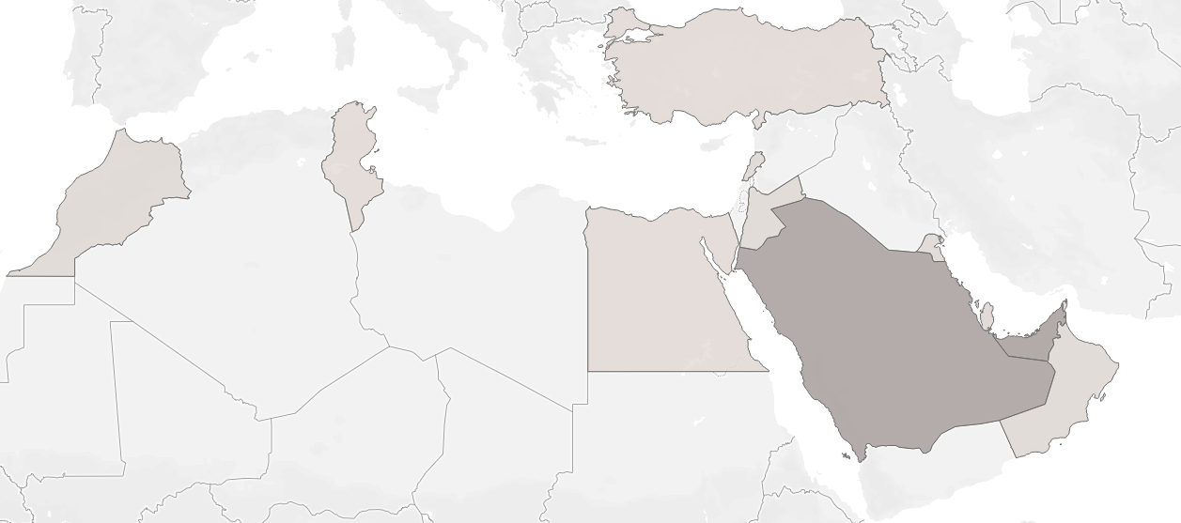
Home to 29% of the BBJ fleet
Turkey 1
Syria
Tunisia 1
Cyprus
Lebanon 2
Morocco 3
Israel
Iraq
Iran
Kuwait 2
Algeria
Jordan 1
Libya
Egypt 1
Bahrain 3
Governments
VVIPs
Charter companies
Corporations
Qatar 3
UAE 29
Saudi Arabia 27
Oman 2
Sudan
Yemen
Source: Boeing analysis
Notes:
And with the Middle East showing such preference for these airplanes, it still may surprise, that the Middle East accounts for nearly 1/3rd of the BBJ fleet at 29% of the worldwide count.
Largest being Saudi Arabia and UAE, the 2nd and 3rd largest countries for BBJ placements, after the USA.
Of course, there are couple of nations that we don’t currently have BBJs in place, most notably Israel, and we’ve put a strong team in place to maintain and grow our success in this region.
We’ve got the biggest charter operator of BBJs in this region in Royal Jet, multiple corporations and UHNWIs with BBJs, and of course a very large quantity of government aircraft.
Numbers are based on Oren’s assessment in mid-November.

Slide 6
Why does the Middle East prefer large cabins?
Expectations – space and privacy highly valued
Travel preference – travel with family and staff is common
Geography – major population centers are 6 to 12 hours away
Wealth – capital is focused in the highest percentiles
Notes:
What are those reasons:
This region sets the highest expectations for service, luxury, and space. While also being geographically situated such that it can be served very well by BBJs.

Slide 7
Middle East wealth resembles US proportions
Millionaires per 10K
Multi-Millionaires per 100K
Billionaires per 10M
USA
152
67
22
Israel
102
53
23
UAE
89
39
14
Qatar
84
36
11
Saudi Arabia
11
6
2
Turkey
4
2
1
Source: New World Wealth Reports, 2021
Notes:
Looking more closely at wealth, the top nations in the Middle East are approaching the level of wealth per capita only seen in the USA. Israel truly is becoming little America. Whether we look at millionaires, multi millionaires (10M+) or billionaires, we see a similar ratio of UHNWI per population.

Slide 8
Privacy, comfort, elegance, and capacity
The Points Guy Global 7500 Review
Notes:
First of all, is the cabin experience…
The purpose-built large long range business jets offer a top notch product, compared to a challenger or citation, you’ll note a few things:
Elegant, luxurious, high end materials, along with items things you don’t see like low cabin altitude, a bedroom, a cabin crew rest option, washrooms, very nice indeed for 8+ figures and $75M-$80M USD it is beautiful, but one thing it is not

Slide 9
But BBJ is simply an entirely elevated experience
Courtesy of Alberto Pinto and Associated Air Center
Notes:
Is a BBJ
A bit more money, but a completely new dimension in the onboard 5-star experience
True private rooms, proper full-size showers, queen and kind sized beds if desired, and working/relaxation spaces that give you a completely different and relaxing, spacious experience.

Slide 10
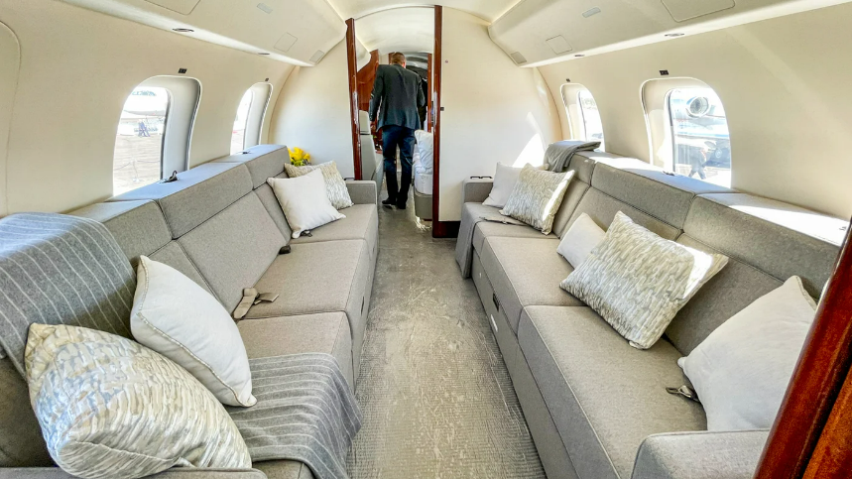
“Majlis”
The Points Guy Global 7500 Review
Notes:
The completely different feel is apparent here as well in the “Majlis”

Slide 11
Majlis
Courtesy of Jet Aviation
Notes:
Or…if you’re investing this much money in your travel experience, perhaps you prefer a proper Majlis,
The BBJ experience speaks for itself, and yes, there is a difference, and one which is appreciated here in the Middle East market more than most.

Slide 12
You might forget you’re on an airplane
Notes:
And of course, there is nothing comparable to the walk-by aisles and private rooms available on the bizliner, which allows different bedtimes, full access to the airplane by staff throughout
There are real reasons that our customers continue to push for larger cabin spaces, luxury amenities like in their homes and boats, and why not when you’re paying 8-9 figures for your airplane

Slide 13
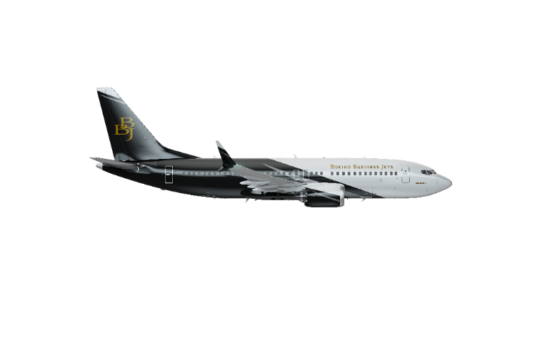
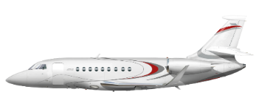
Larger airplane – greater cost?
* Sampling obtained from Conklin and de Decker
Notes:
The BBJ category breaks the trend. Using a commercial platform for business aviation benefits from the economies of scale that are inherent to our products, and their design for maintenance and reliability.
The Middle East boasts a customer type that cares very much about reliability – governments. At BBJ we’re proud of our success in both of these market categories.
DATA:
Super midsize Falcon 2000, Citation Sovereign, G280
Large jets Falcon 900LX/EX, Global 5000, G450
Large ULR G650ER, G700, Global 7500
BBJ 737-7
Aircraft images:
Small: Falcon 2000
Large: Global 5000
Large ULR: G650
BBJ: 737-7

Slide 14
44 head of state widebody aircraft in the Middle East
Source: publicly available data. Only includes in-service widebody aircraft fully dedicated to head of state transport.
Notes:
In the Middle East there are 44 widebody aircraft operated for Heads of State. Contrast this with North America, where there are less than 10.
Note that this includes both direct sale VIP aircraft, and commercial aircraft converted to VIP service.
And, of the 44 widebody Head of State widebody airplanes in the Middle East…
Includes only in-service widebodies in full-time HoS service. Ignores narrowbodies and purpose built bizjets.

Slide 15
Governments choose Boeing for flagship aircraft
Boeing
Competition
32 aircraft
12 aircraft
Source: publicly available data. Only includes in-service widebody aircraft fully dedicated to head of state transport.
Notes:
3/4ths of them are Boeings
So, for gov’t flagship aircraft, for their most important passengers, Boeing jets are significantly preferred.
Includes only in-service widebodies in full-time HoS service. Ignores narrowbodies and typical bizjets.

Slide 16
Governments choose Boeing for flagship aircraft
Boeing
Competition
Bahrain
UAE
Egypt
Kuwait
Algeria
Iran
Morocco
Oman
Israel
Qatar
Libya
32 aircraft
Turkey
12 aircraft
Saudi Arabia
Source: publicly available data. Only includes in-service widebody aircraft fully dedicated to head of state transport.
Notes:
Looking at which countries have chosen which aircraft for their flagship, we’re proud to have nearly every country we’re allowed to sell to, in the Boeing camp. Moreover, all 4 countries who have both Boeing and the competitor’s aircraft have made their most recent purchase from us.
Yes, we have included the Israeli “wing of zion” which is a 767-300ER even though it has not been entered into service yet. But we are proud to be the lift provider for the Israeli gov’t.
Includes only in-service widebodies in full-time HoS service. Ignores narrowbodies and typical bizjets.

Slide 17
Fly without compromise

